Slide 1
Introduction to Machine Learning
Layers and Neural Networks

Slide 2



Layers are made by multiple neurons
Input
$$x_{1}$$
$$x_{2}$$
$$x_{3}$$
Input „Layer“
Layer 0

Slide 3
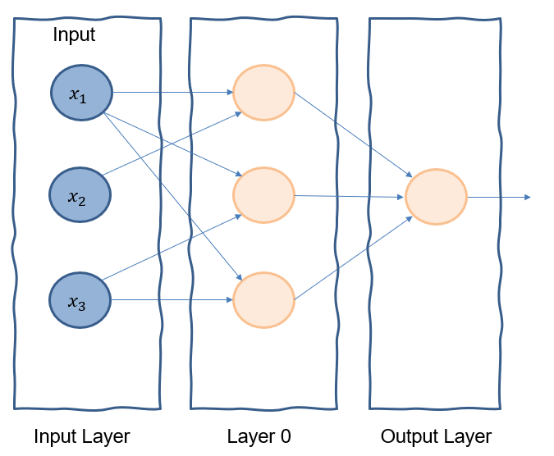
Neural Networks, Input Layer, Output Layer, Hidden Layer
The structure of connected neurons is called (Artificial) Neural Network.
If we structure the neurons and connections in layers:
The first layer (being the feature vector) is called Input Layer.
The last layer (generating the output) is called Output Layer.
All other layers are called Hidden Layers

Slide 4



Deep Neural Networks
Neural Networks with hidden layers are called Deep Neural Networks.
$$x_{1}$$
$$x_{2}$$
$$x_{3}$$
Input Layer
(Hidden)
Layer 0
(Hidden)
Layer 1
Output Layer

Slide 5
Deep Neural Networks
Neural Networks with hidden layers are called Deep Neural Networks.
$$x_{1}$$
$$x_{2}$$
$$x_{3}$$
Input Layer
(Hidden)
Layer 0
(Hidden)
Layer 1
Output Layer

